Slide 1
CLOUD CAMPUS
Submitted By:-KANISHKA DHIR
CSE 2K15
Uni Roll No:15110169

Slide 2
INTRODUCTION
Cloud Campus is an educational portal providing efficient way of communication between students and faculties, hence smooth functioning of an Institute.
Website will provide lists of all the learning institutes regarding their students and the activities going on their campus.
Each Institute aims at bridging the gap between students and the faculty of the colleges.
Along with information, students can discuss with each other and also ask queries.
Institutes can conduct their tests, events and notices for the students
Cloud Campus is a powerful catalyst for improving students’ performance by taking Tests which is an advanced and quick way of learning.
It is an online campus where different institutes can register themselves even if they don’t have their own website,this provide the same functionality to them.
Records of various institutes can be compared for the students to get an overview to enroll in which institute.

Slide 3
FEATURES OF PROJECT
The main objective behind the development of this project is to create application with the following features:
Highly user-friendly
Cross-platform
Easy-to-use
Contains database
Free from errors
Data entry to avoid incorrect information at different consoles

Slide 4
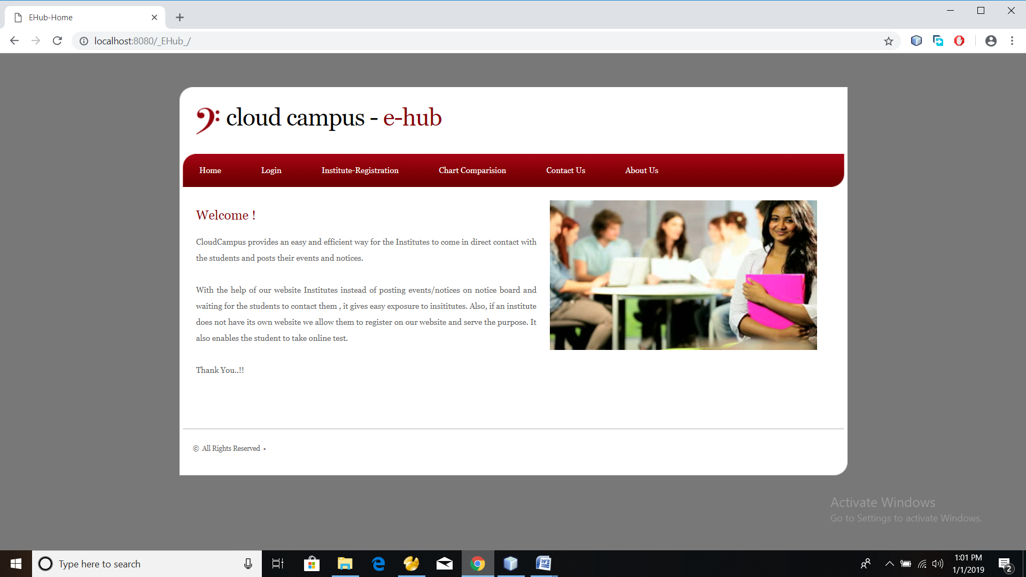
MODULES OF PROJECT
This project consists
of three modules:-
1. Institute Module
2. Faculty Module
3. Student Module

Slide 5
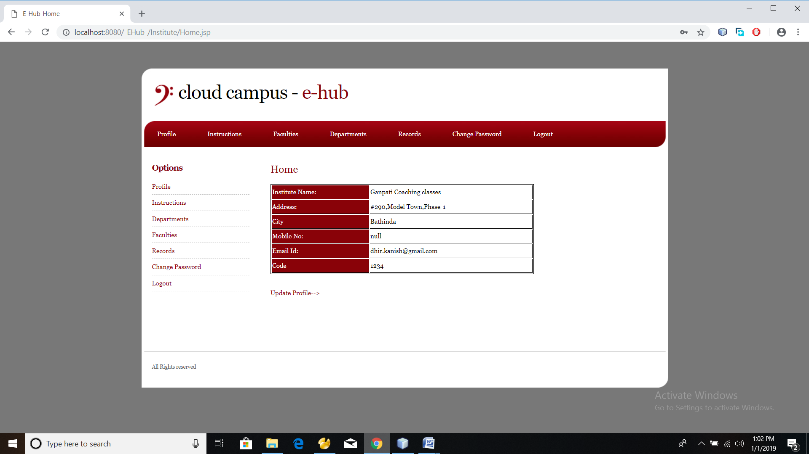
INSTITUTE MODULE
The main tasks of an institute are:-
Register institute
Create Faculty Logins
Add/List various departments
Add previous records
Recover forgotten password by sms facility
Can change password
Records can be compared with other institutes with chart comparision

Slide 6
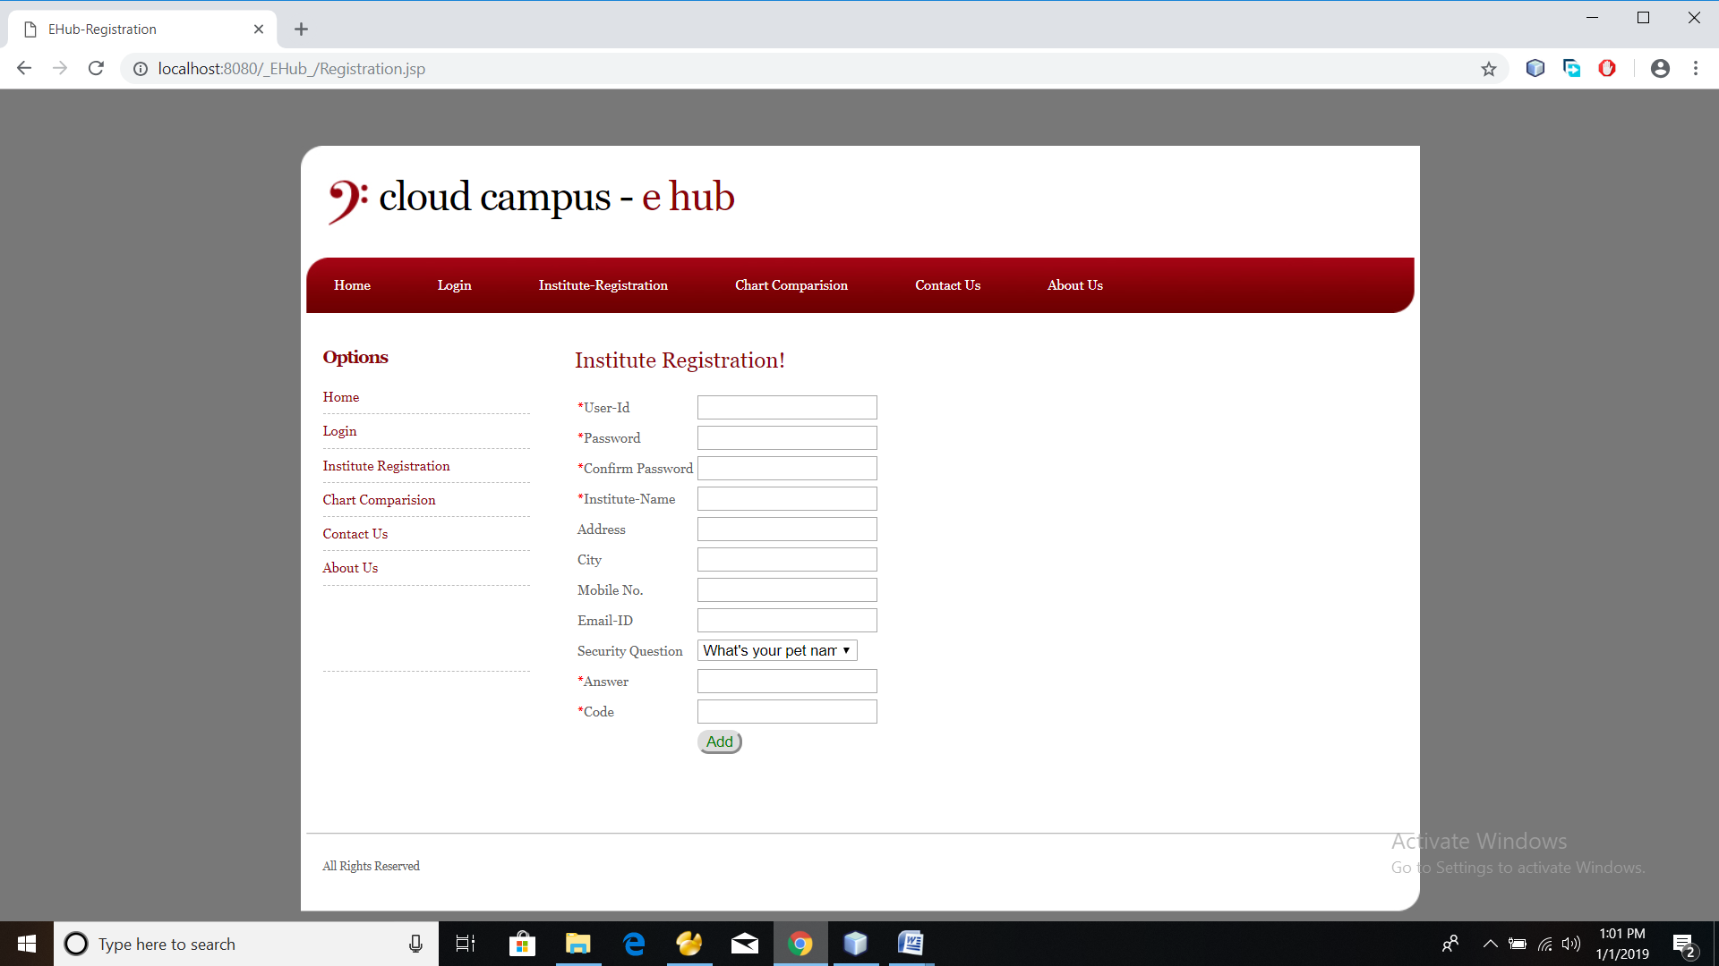
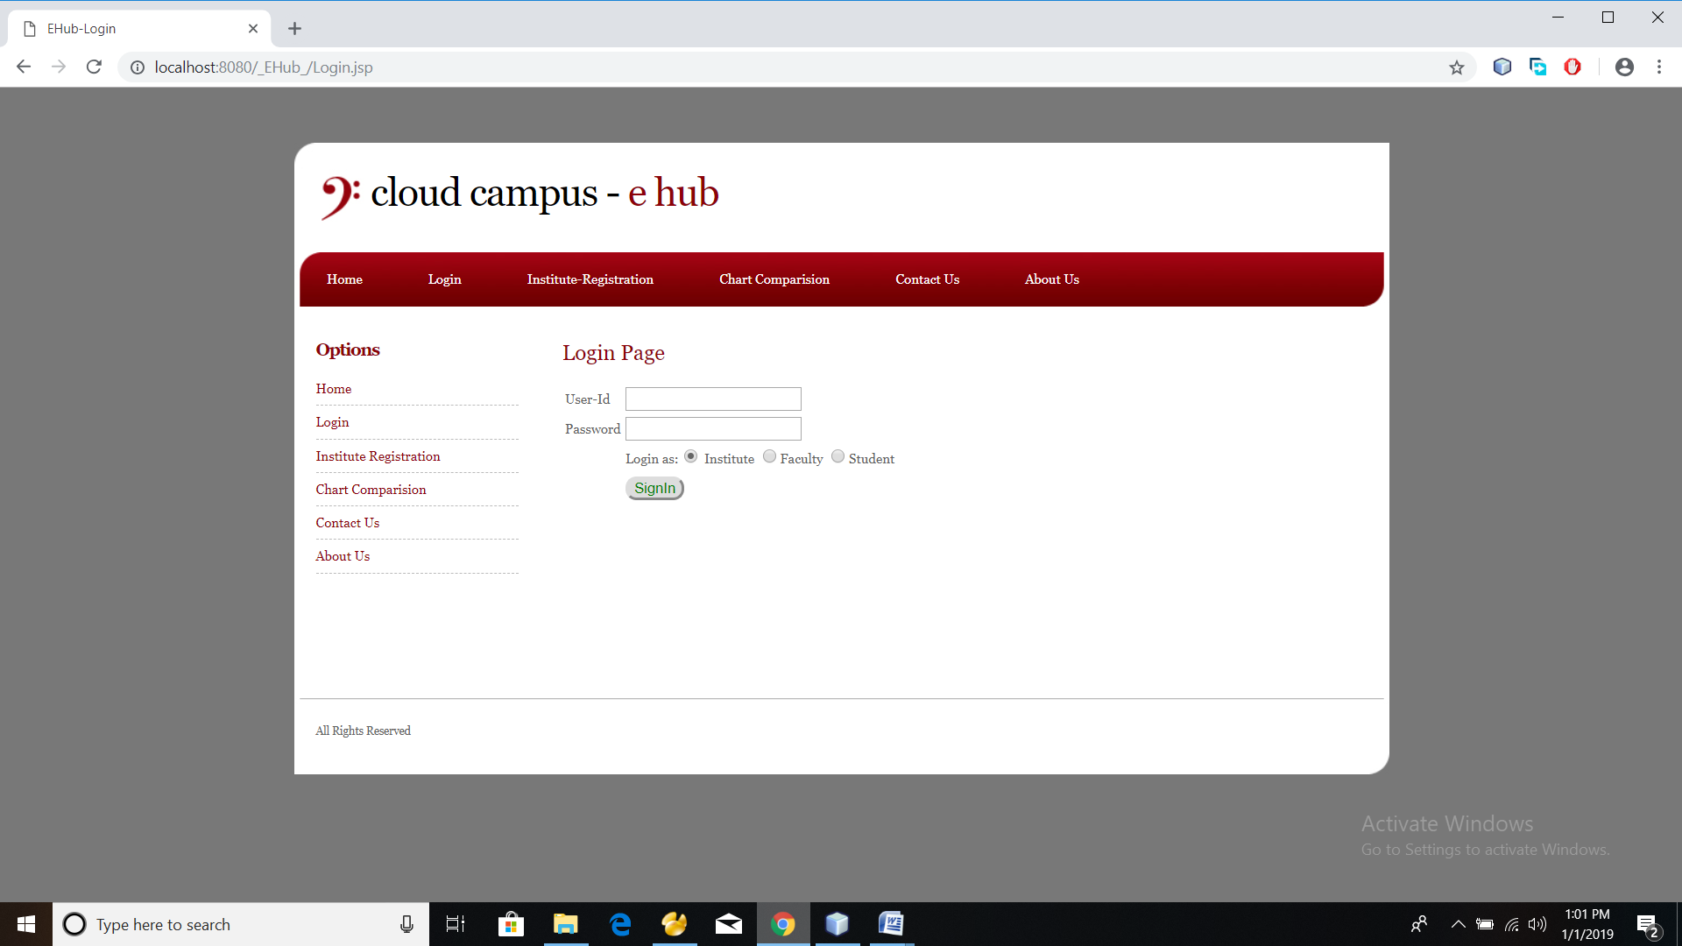
Registration Login Profile

Slide 7
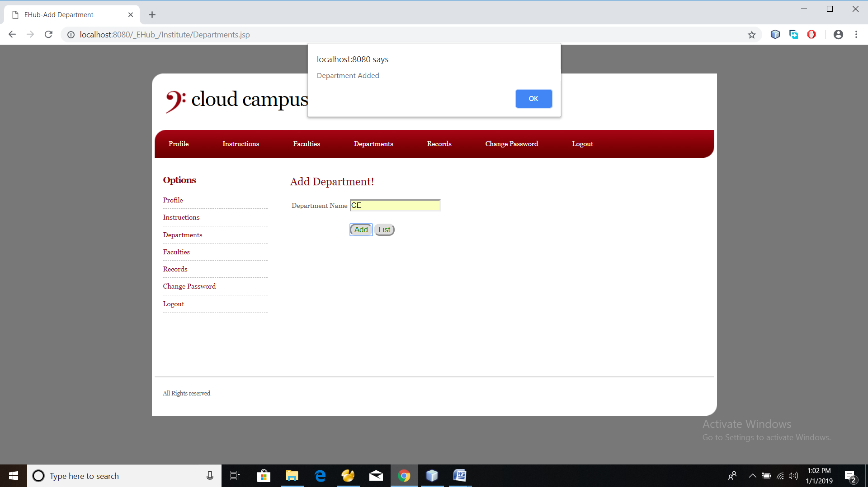
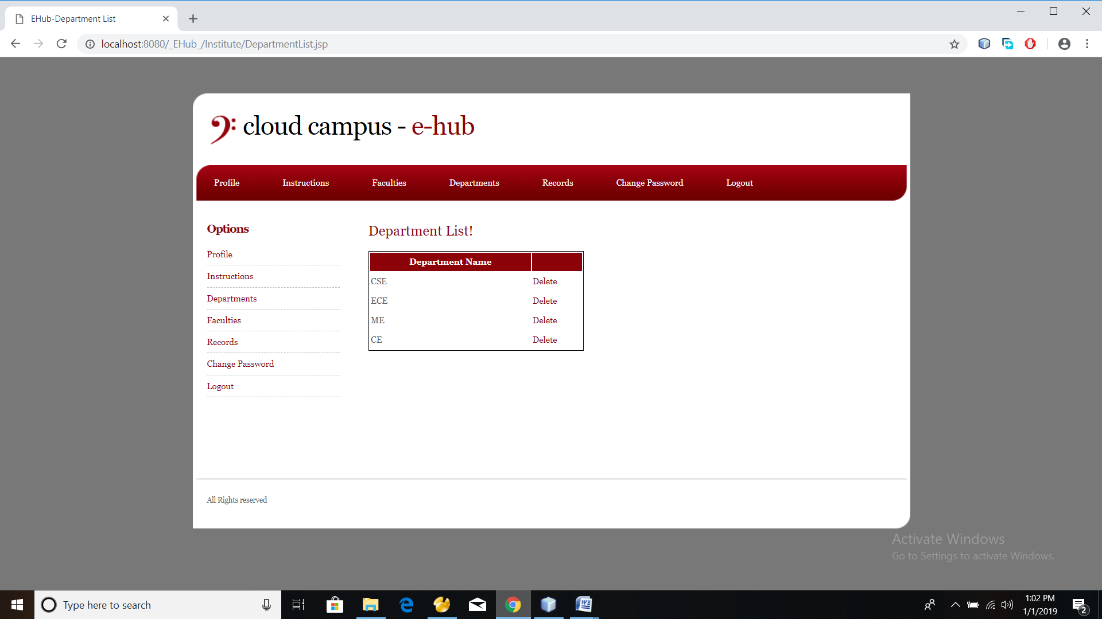
Department Added Department List

Slide 8
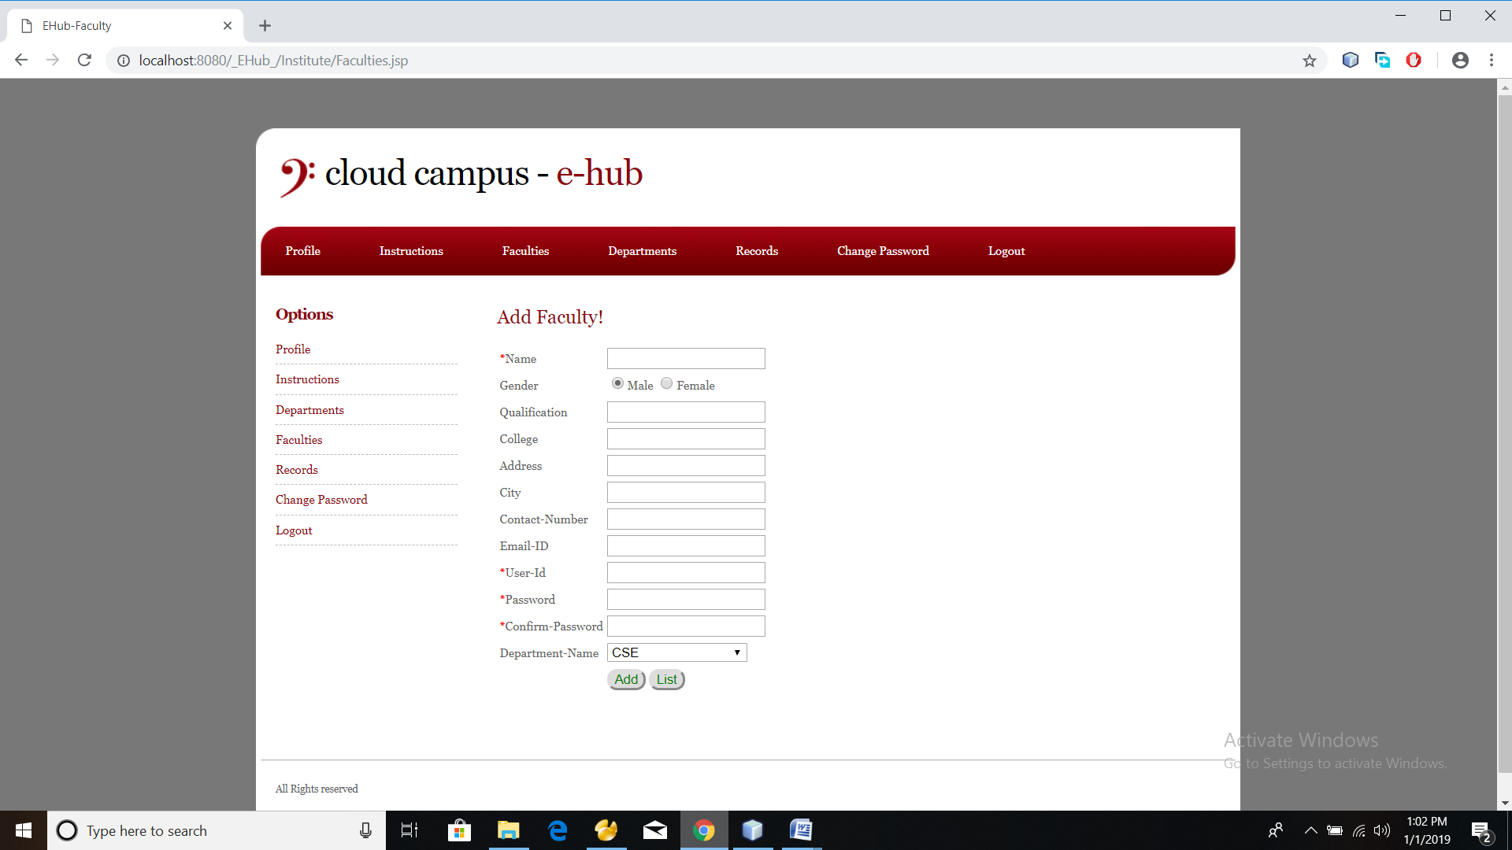
Create Faculty Login
Institute admin has the responsibility of creating login id’s for faculty members.

Slide 9
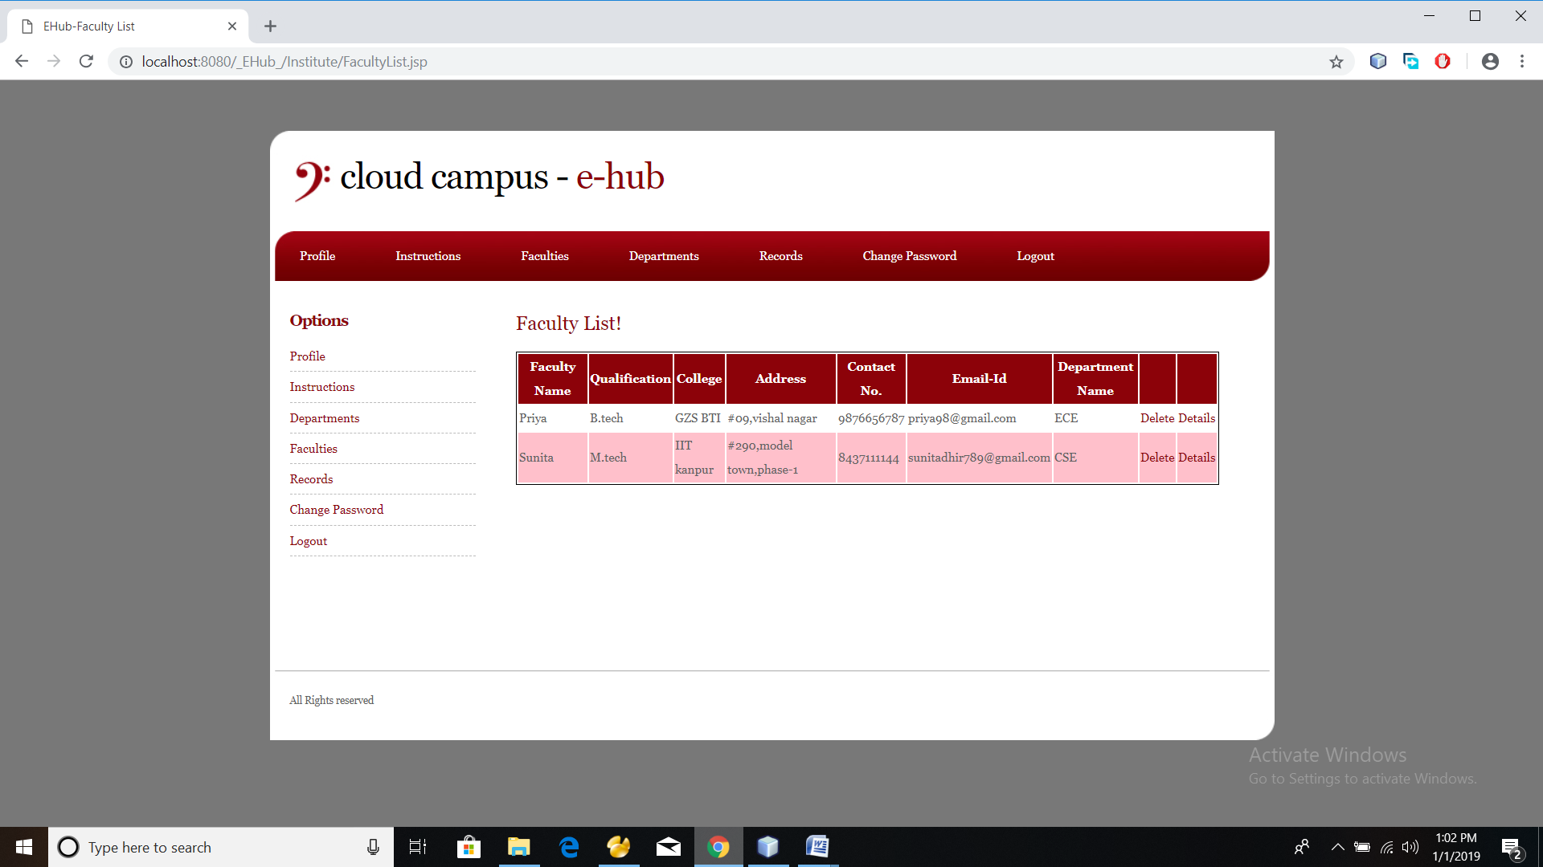
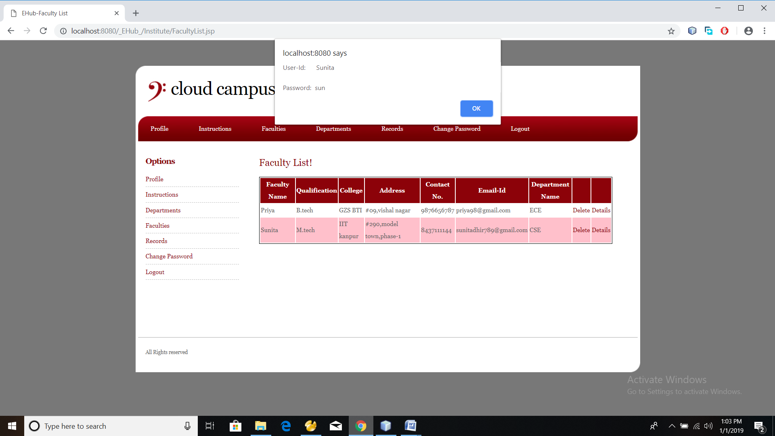
Faculty List Faculty Details

Slide 10
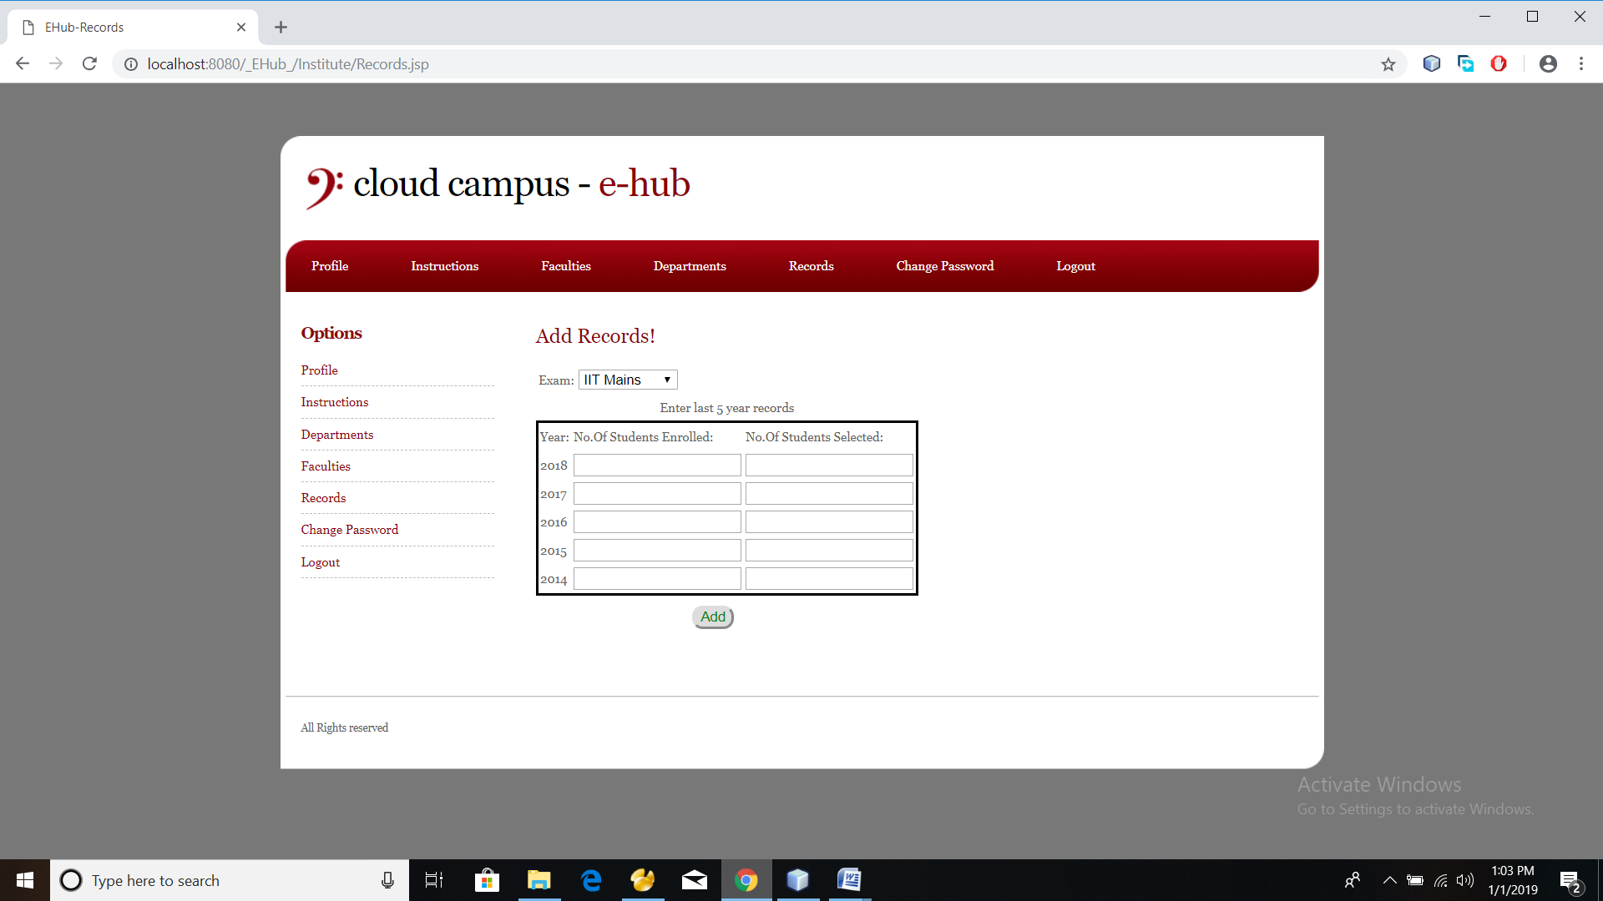
Records
Institute’s previous year records are saved. For a particular exam no. of enrolled and selected students is saved . This data is used for a non user to check the institutes performance.

Slide 11
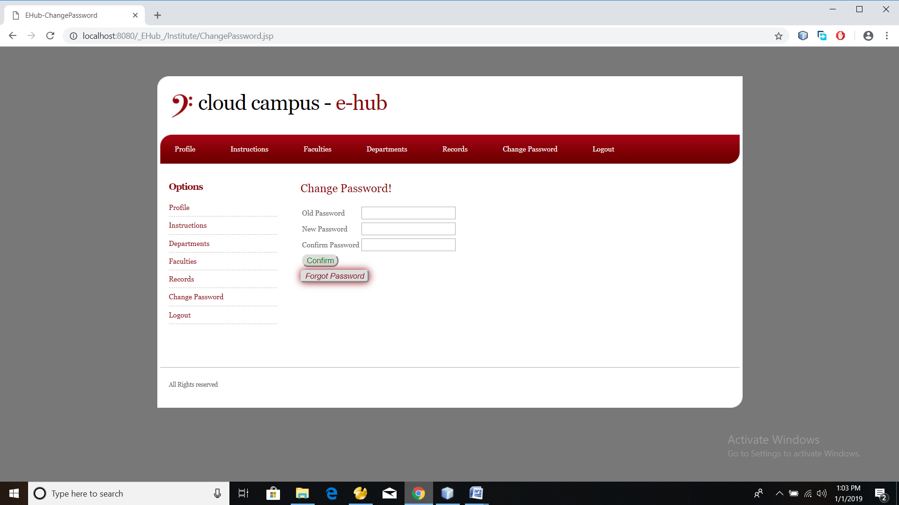
Change Password
Password can be changed .
If password if forgotten then it can be recovered by sending the security question to user.

Slide 12
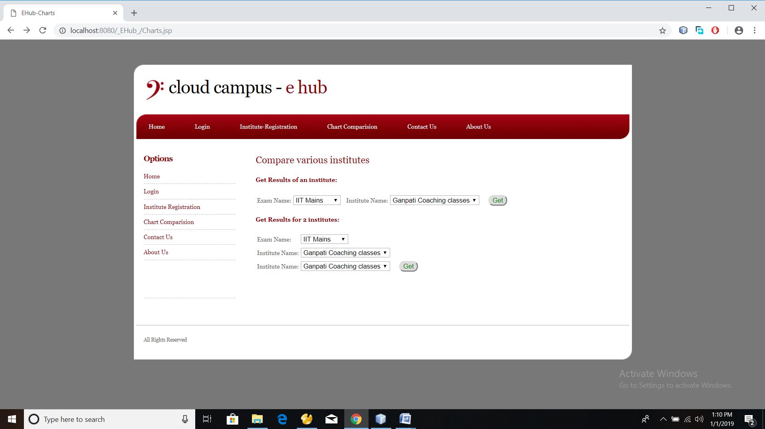
Chart comparison
Records of an institutes can be compared with any other institute as well as an institute’s enrolled v/s selected students can be compared for a particular exam.

Slide 13
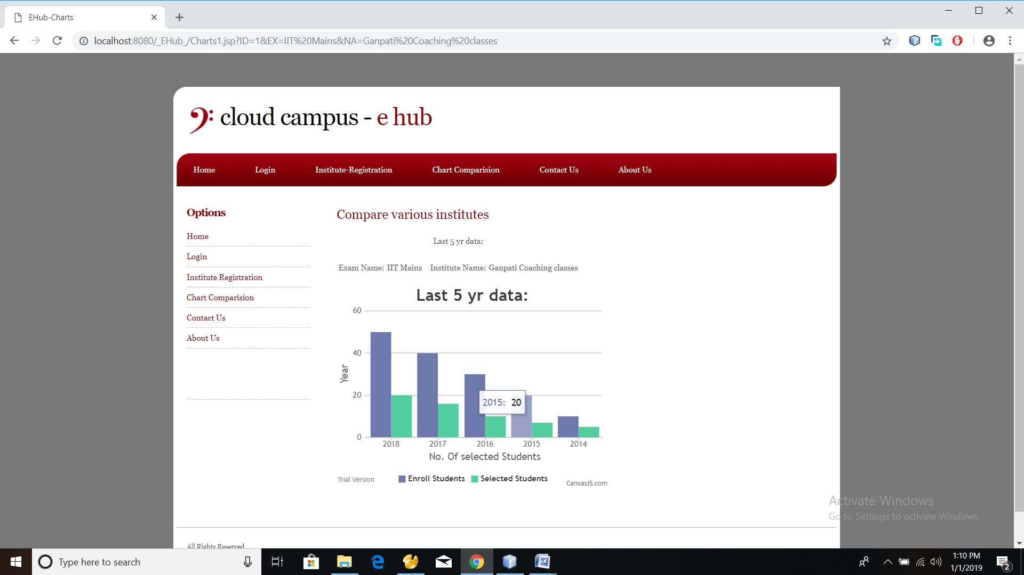
Comparing an institute

Slide 14
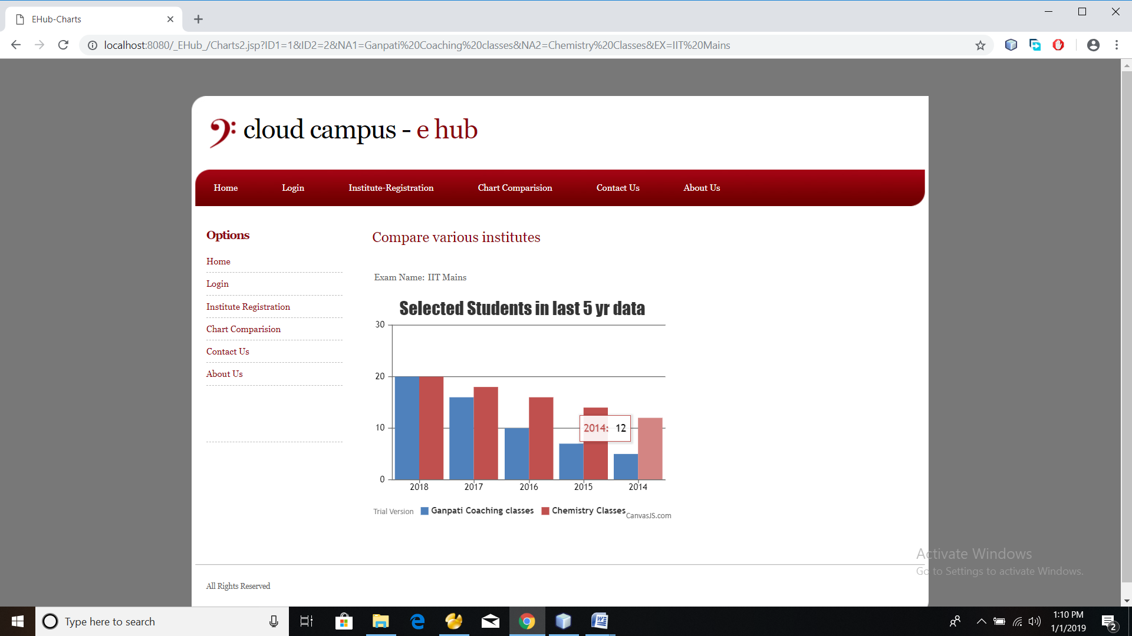
Comparing two institutes

Slide 15
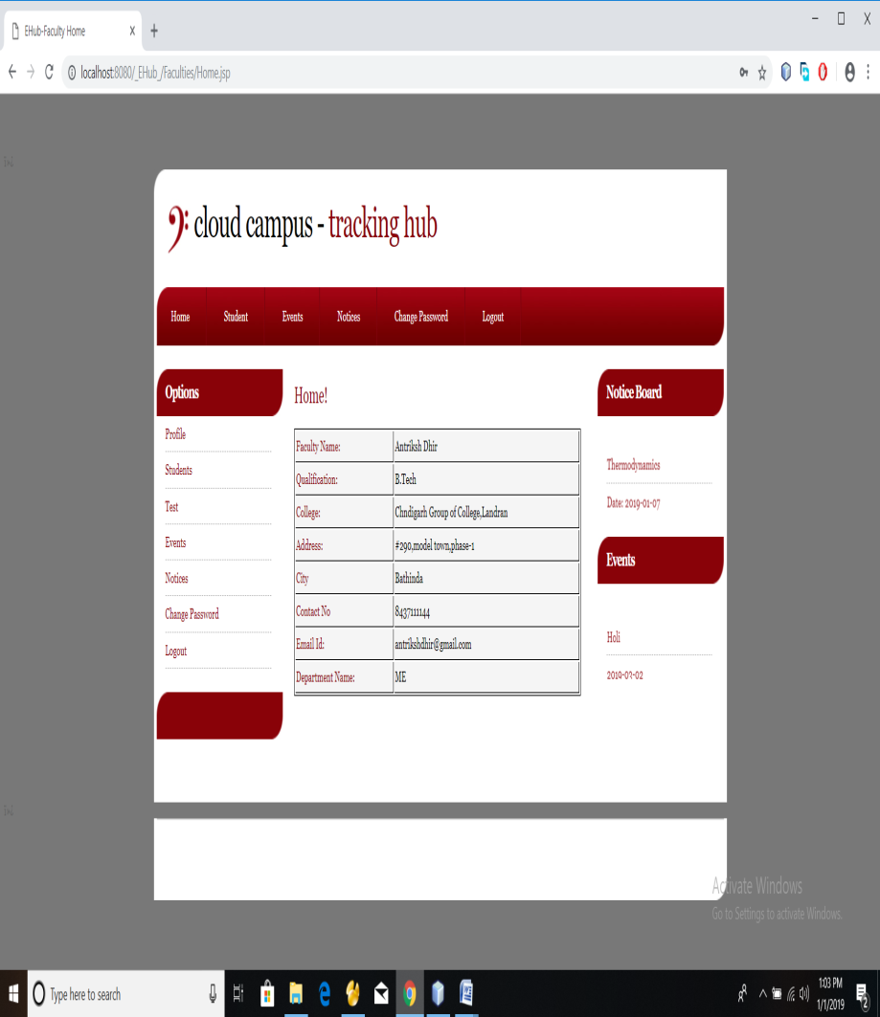
FACULTY MODULE
Faculty once logged in, has following main tasks-
Create Student Logins
Schedule Tests
Tests questions and options can be exported from excel sheets
Status of students who have given tests
Create and List Events
Give Notices to Students
Status of Registered Students for various Events

Slide 16
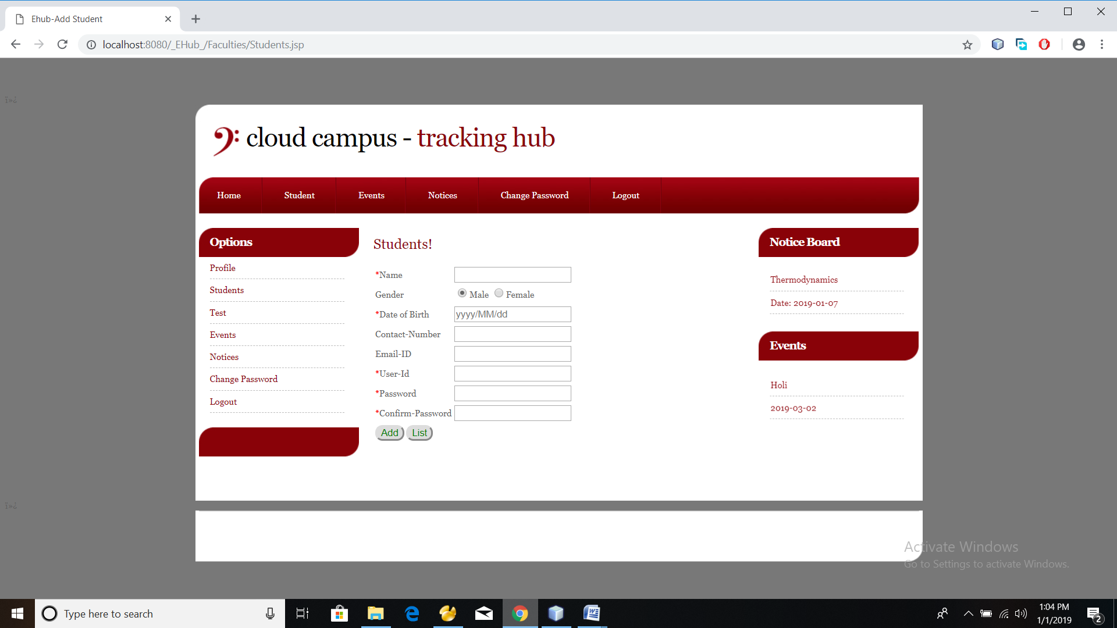
Create Student Login
Faculty has the responsibility of creating login
id’s for students.

Slide 17
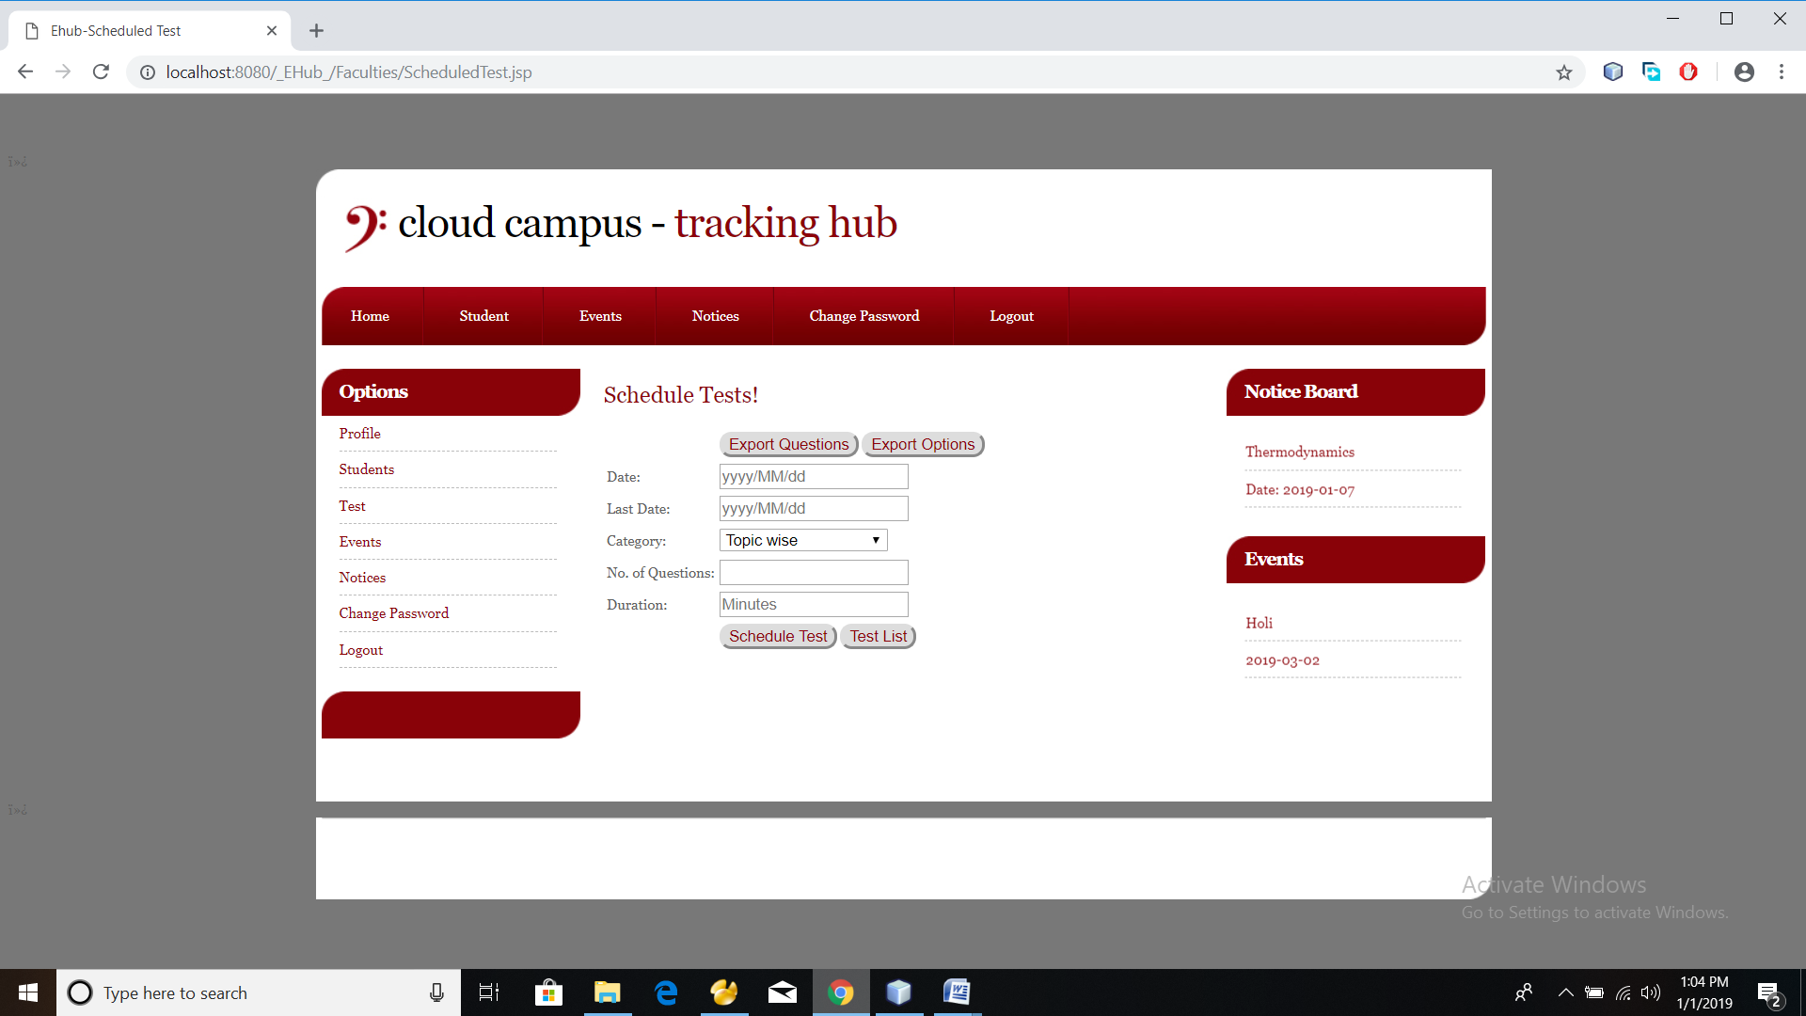
Schedule Tests
Faculty can schedule tests for the students to appear .
They can also view test list as well as students that appeared in the test along with the details of their test.

Slide 18

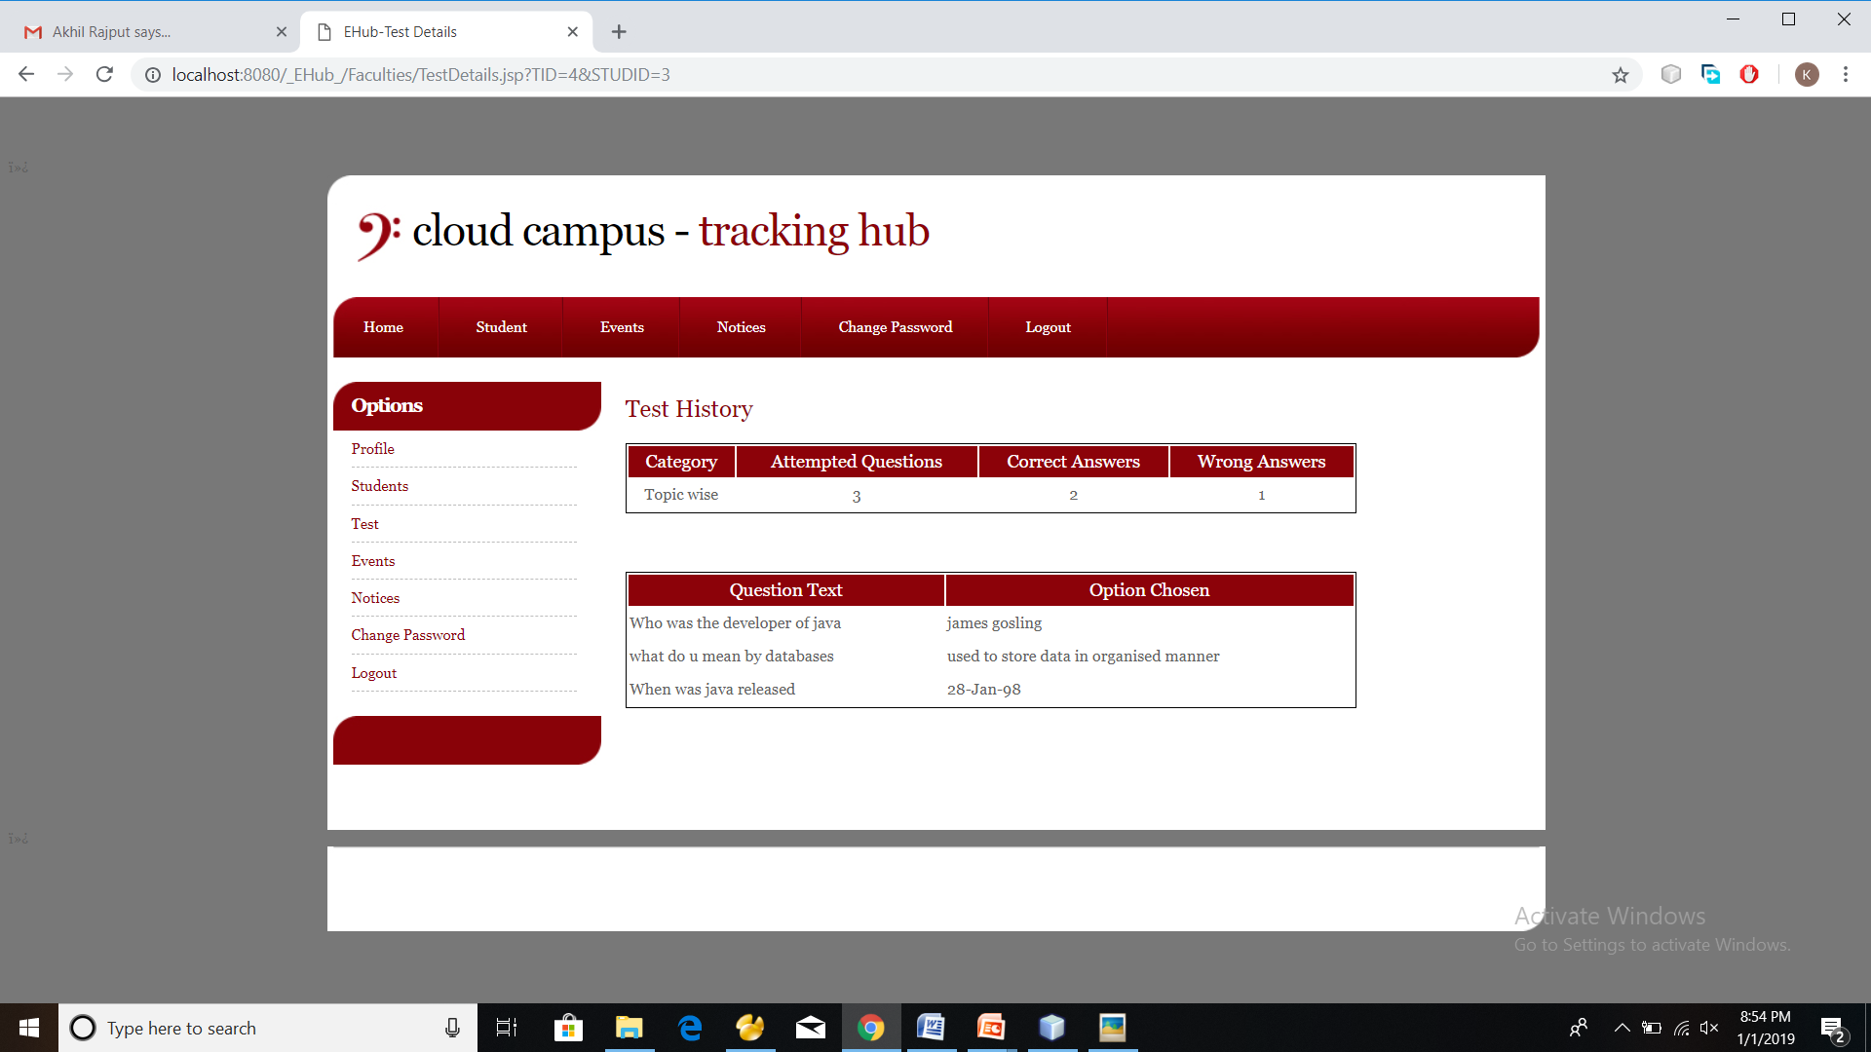
Test List Test Details

Slide 19
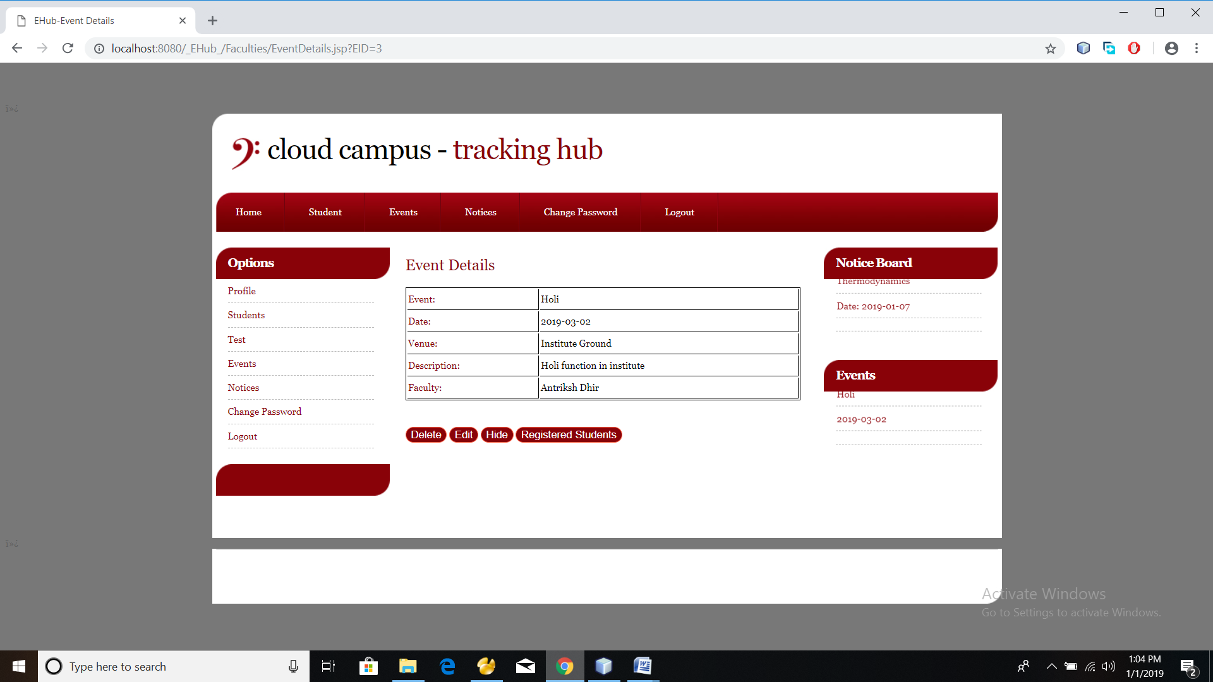
Manage Events
Faculty members can add/delete/edit/hide events organized in institute.
They can also view all the registered students for the event.

Slide 20
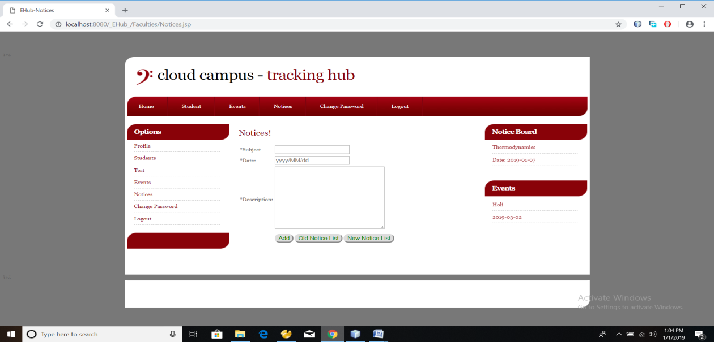
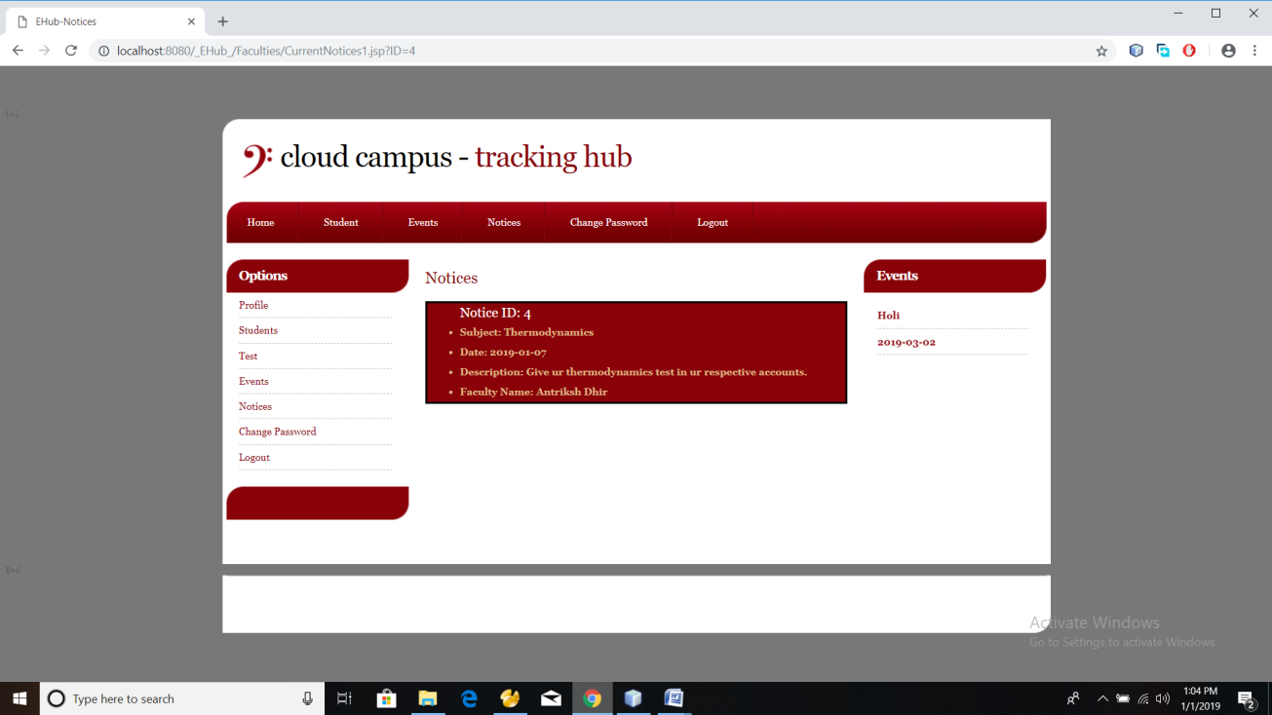
Notices
Faculty can also notify students about the current updates in their schedule or academics by a notice.

Slide 21
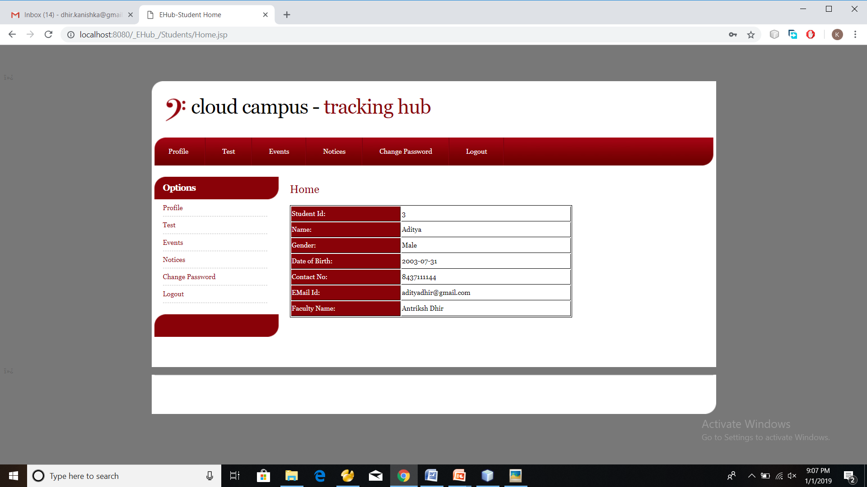
STUDENT MODULE
Student logs in, is entitled for further services by Cloud Campus-
View Scheduled Tests and appear for them.
List Events and participate in Open Events
View Notices given by their faculties
View Registered Events.

Slide 22
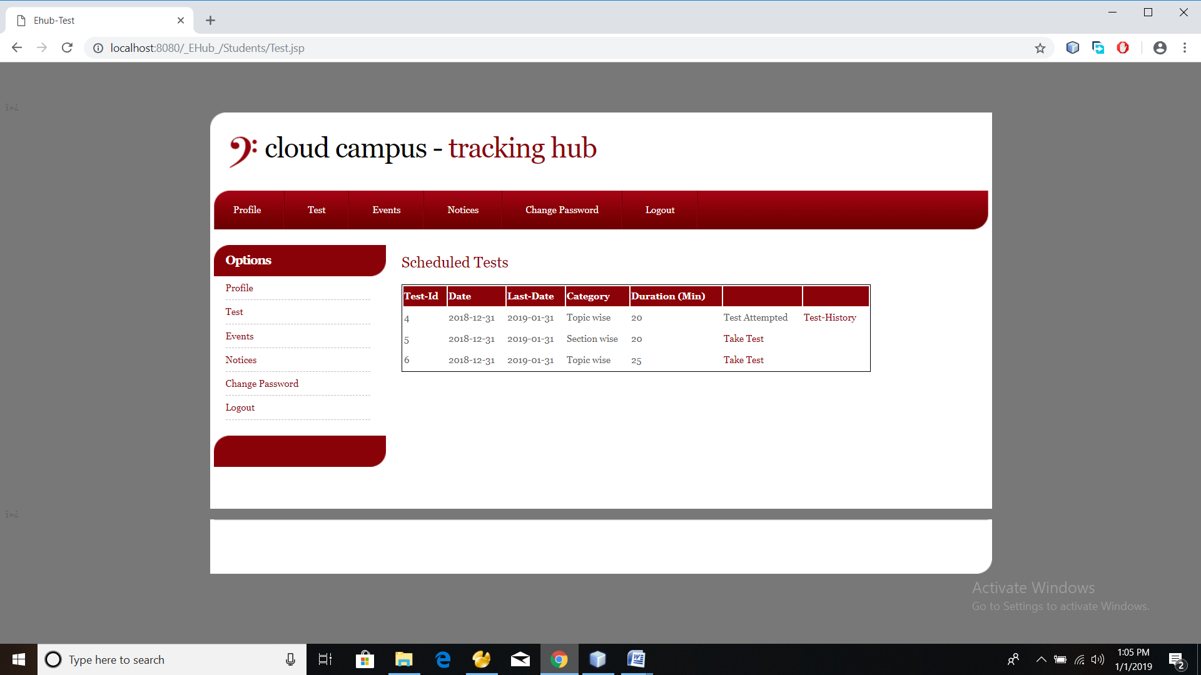
Test Section
Students shall appear for the tests and can also get their test history.

Slide 23
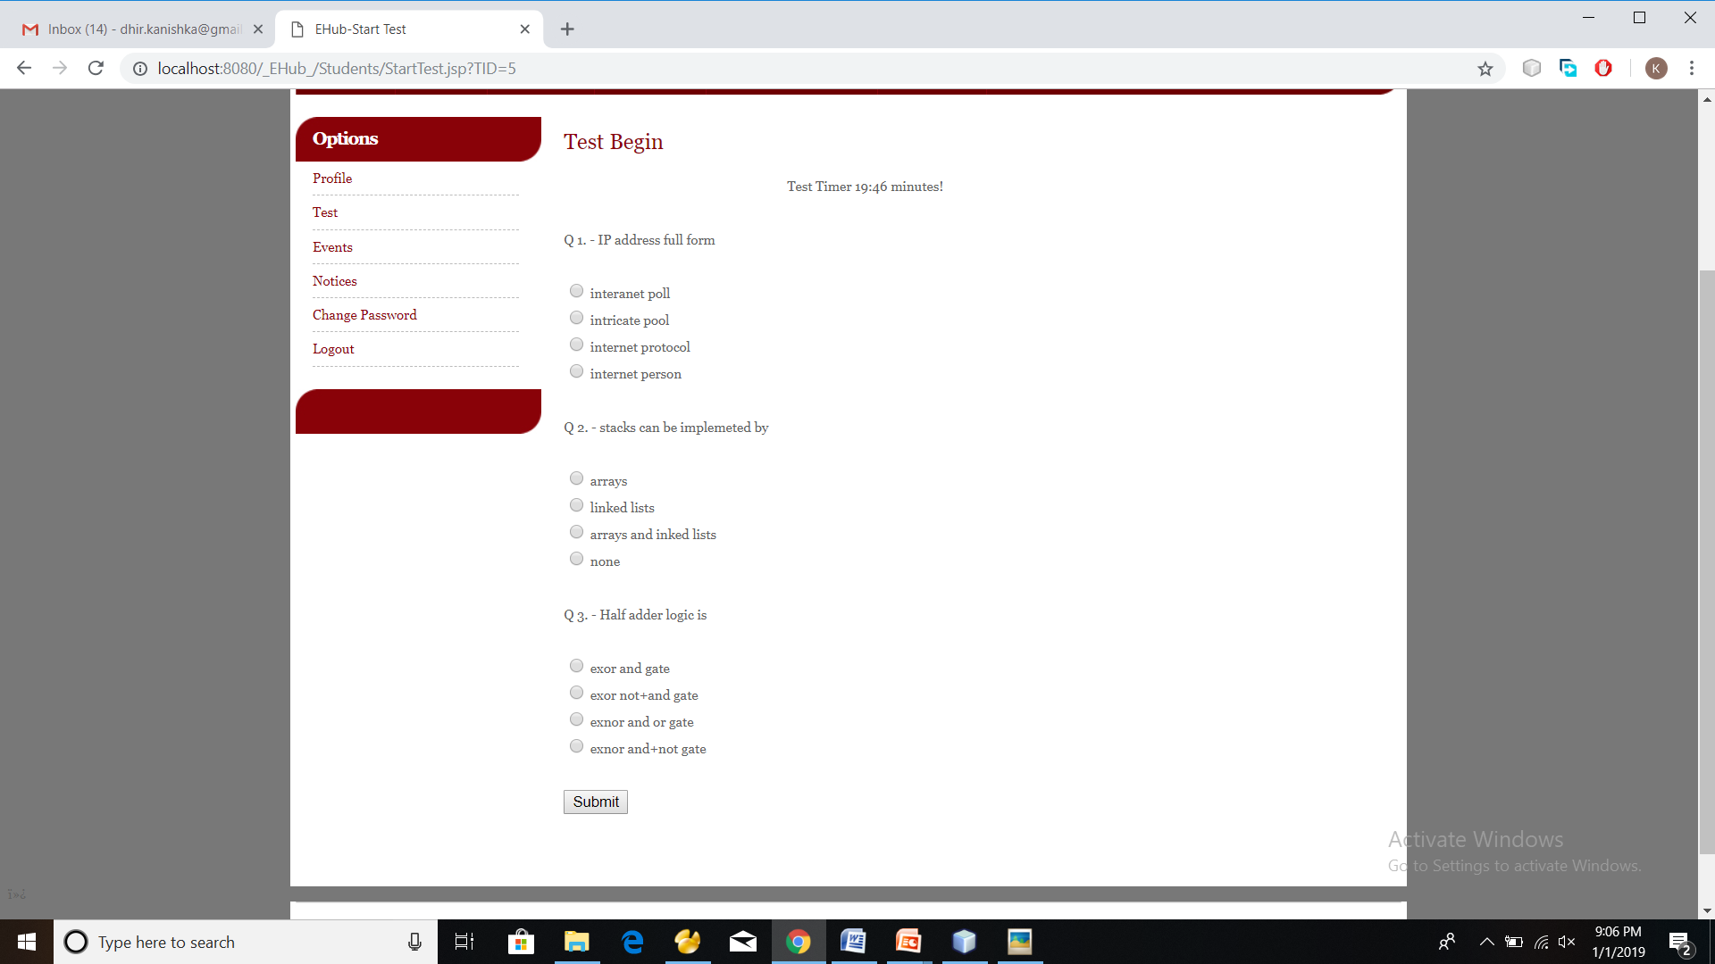
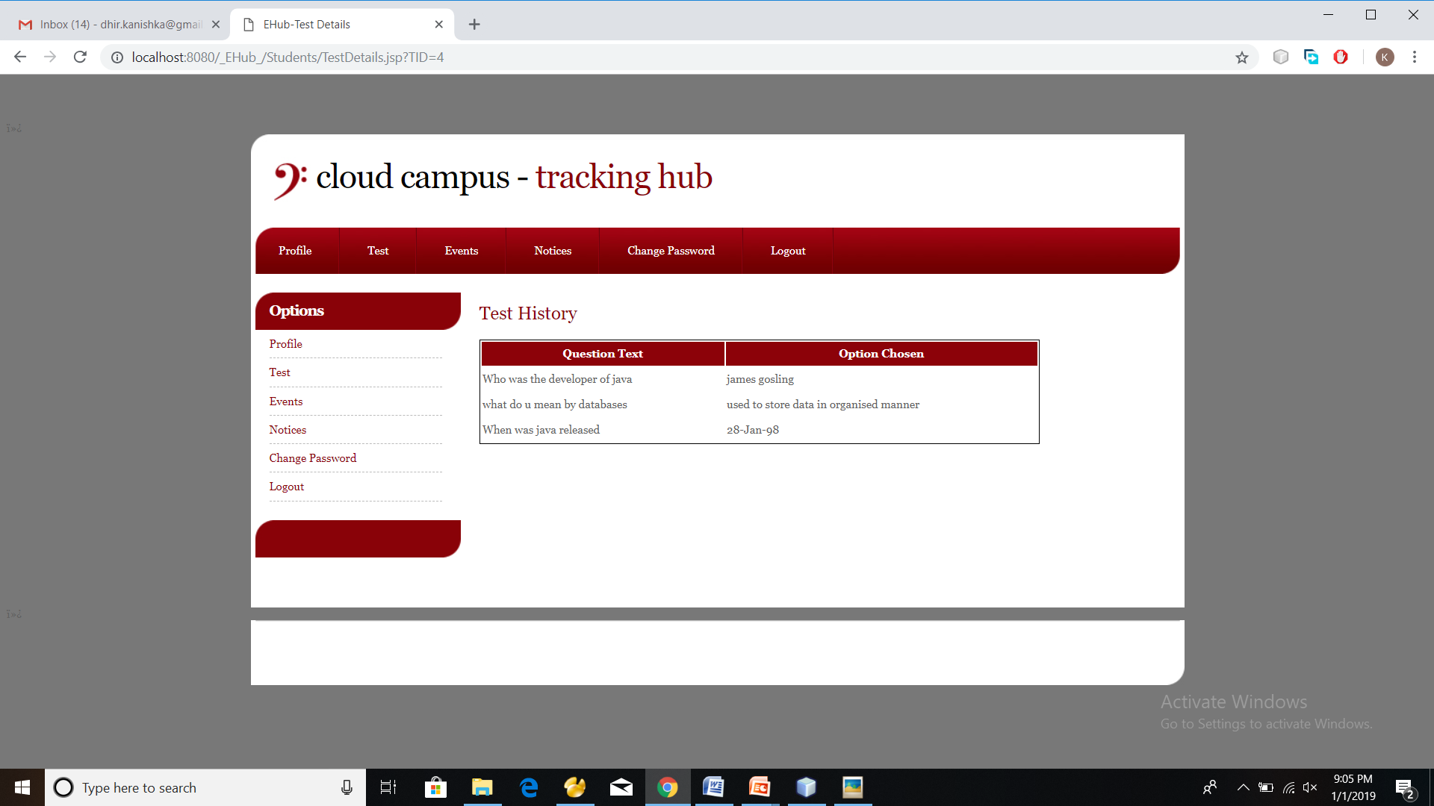
Giving Test Test History

Slide 24
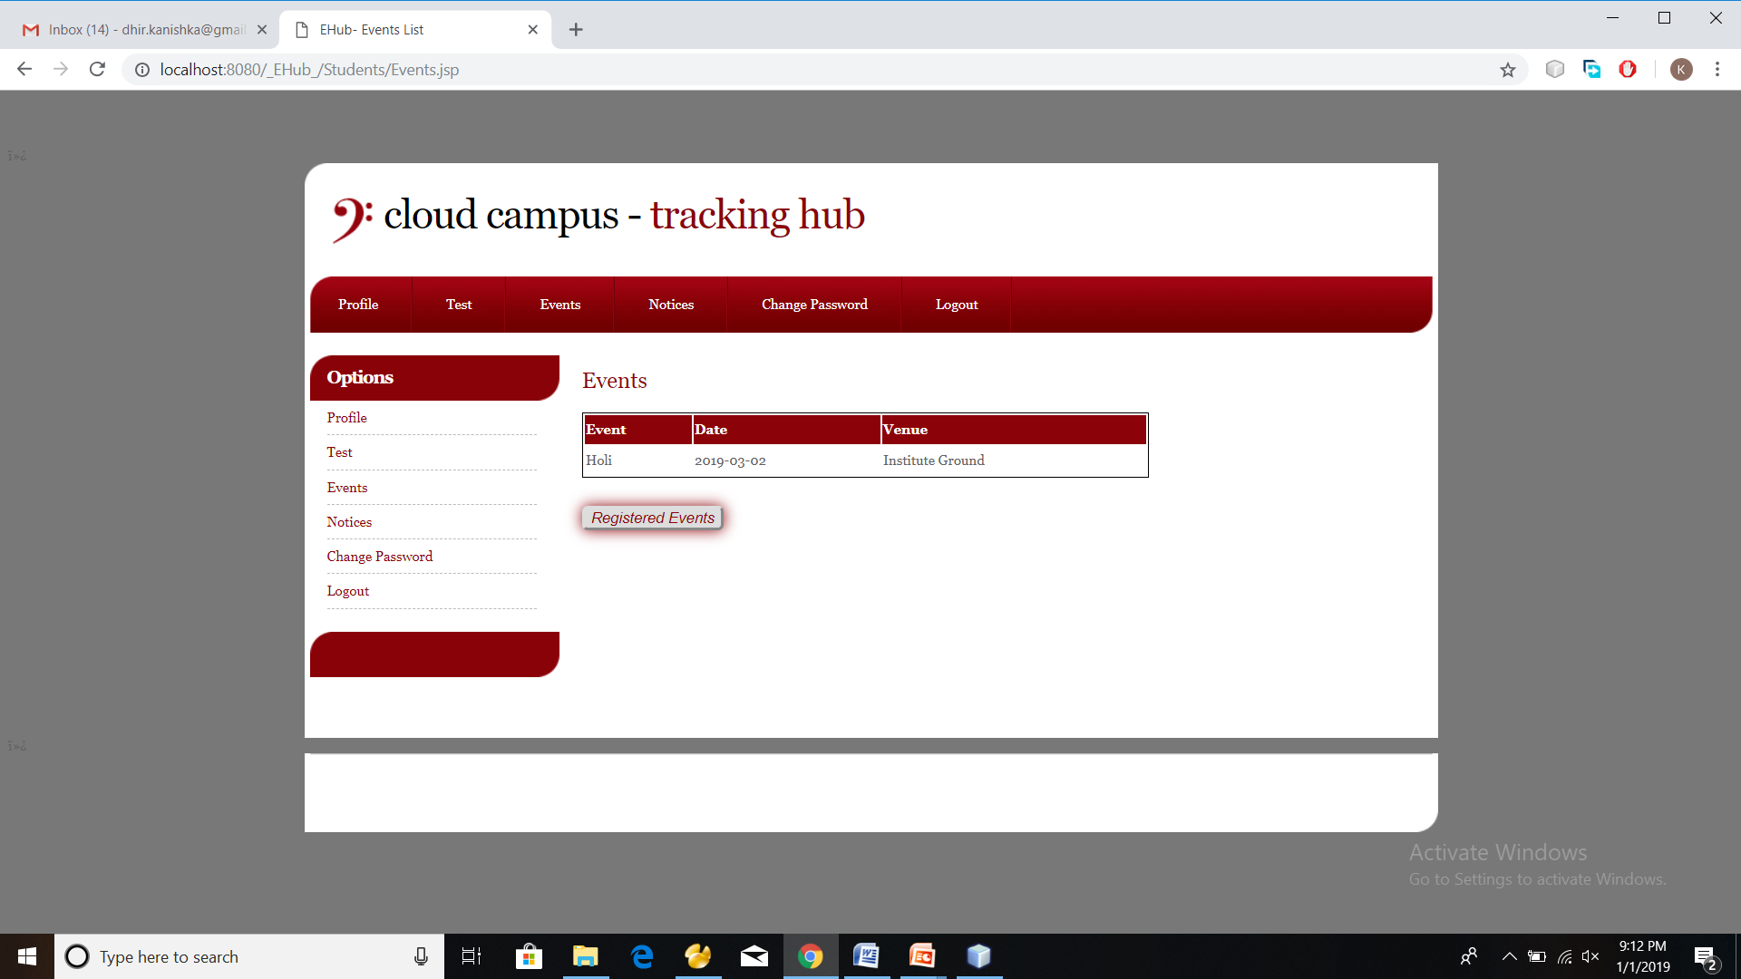
Events
Students can register themselves for any events being organized in the institution.

Slide 25
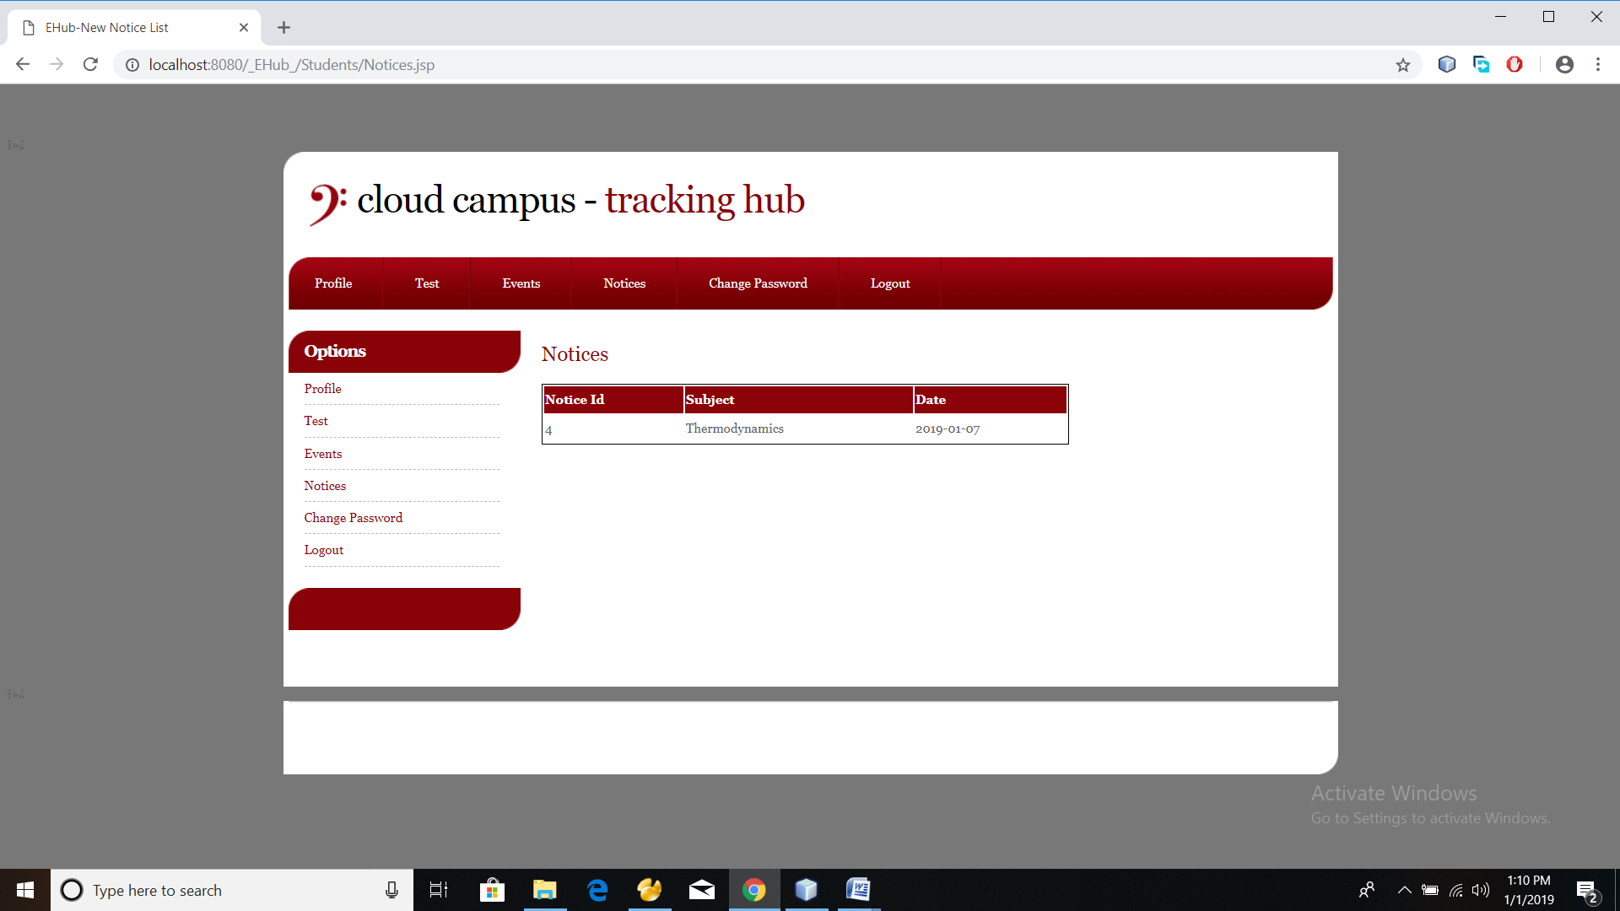
View Notices
Students can view notices of their own department only not of the entire institute.
They can remain updated with all current academic changes.

Slide 26
THANK YOU!

